Slide 1
Airway
Dr. Lauren Bailey

Slide 2
Expectations
My role as medical director
Trust
Commitment

Slide 3
Outline
Indications
Resuscitation before intubation
RSI technique
Pharmacology tips
Surgical airway
Equipment- video recording

Slide 4
Who?
Only people above >8 years old
Pediatrics: SGA, NIV

Slide 5
When to intubate?
Can’t oxygenate
Can’t ventilate
Can’t protect airway
Anticipated clinical decline (GCS <8)

Slide 6
How?
Pharmacologically Assisted Intubation
Rapid Sequence Intubation
Delayed Sequence Intubation
Facilitated Intubation

Slide 7
Resuscitation before Intubation

Slide 8
Resuscitation before intubation - ALWAYS!
Correct hypoxia
Stabilize hemodynamics
Address acidosis

Slide 9
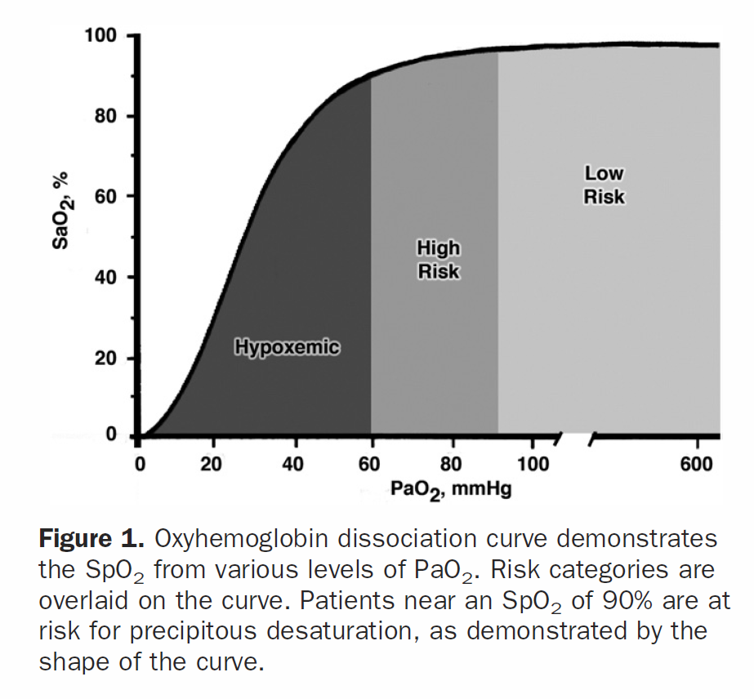
Hypoxia
NRB
Bipap/CPAP
HFNC

Slide 10
Preoxygenation
Extends the duration of “safe apnea” until a pt reaches a sat of 88-90%
Patients breathing room air pre-intubation can desat in 45-60 seconds after paralytic administration

Slide 11
Apneic oxygenation
PREOXI trial: preoxygenation with NIV resulted in a lower incidence of hypoxemia during intubation than preoxygenation with an oxygen mask
https://rebelem.com/the-preoxi-trial-pre-oxygenation-with-niv-vs-facemask/
PPV/PEEP can be safely achieved with NIV/BVM @flush rate/PEEP valve @15cm/H2O, especially when there is time to set up equipment

Slide 12
Apneic oxygenation
My practice: NC@15LPM +/- for 3-5 minutes pre-intubation
Sometimes add bipap
Always maintain NC during intubation

Slide 13
HOB to 30 degrees
Removes weight off chest
Recruits more alveoli
Prevents N/V

Slide 14
Stabilize hemodynamics
Crystalloid
Vasopressors - sepsis, cardiogenic shock, distributive shock (GIB)
Caution in trauma (permissive hypotension)
Maintain MAP > 60, SBP > 100
Choose the right drug, at a lower dose

Slide 15


Slide 16
Push dose pressors
Levophed (preferred):
Mix 4 mg (1 amp) in a 250 ml NS bag for a concentration of 16 mcg/ml
Give 8 to 16mcg (0.5 to 1 ml) every 1-2 minutes as needed to maintain a MAP > 60 or SBP > 100

Slide 17
Push dose pressors
Epinephrine
Take a 10 ml syringe of NS and waste 1 ml, add 1 ml epi from your 1:10,000 epinephrine syringe (100 mcg/ml) for a concentration of 10 mcg/ml of epinephrine
Give 5 mcg (0.5 ml) every 2 minutes to maintain a MAP >60 or SBP >100
Increase dose in increments of 5 mcg (0.5 ml) up to a maximum of 20 mcg (2ml) every 2 minutes as needed
Contraindicated in hypovolemic shock, cardiogenic shock, and trauma

Slide 18
RSI technique

Slide 19
Pretreatment?
Nope
Just O’s through the nose

Slide 20
RSI procedure - SOAPME
Suction — at least one working suction, place it between mattress and bed
Oxygen — NRBM and BVM attached to 15 LPM of O2, preferably with nasal prongs for apneic oxygenation
Airways — 7.5 ET tube with stylet (most adults), 7.0 for smaller females, 8.0 for larger males
— test balloon by filling with 10 cc of air with a syringe — Stylet – place inside ET tube for rigidity, bend it 30 degrees (hockey stick)
— Blade – Mac 3 or 4 for adults – curved blade — Handle – attach blade and make sure light source works — Backups – ALWAYS have a surgical cric kit available! — have video laryngoscope, LMA and bougie at bedside
Pre-oxygenate
— 15 LPM NRBM
Monitoring equipment/Medications — Cardiac monitor, pulse ox, BP cuff opposite arm with IV — Medications drawn up and ready to be given
End Tidal CO2

Slide 21
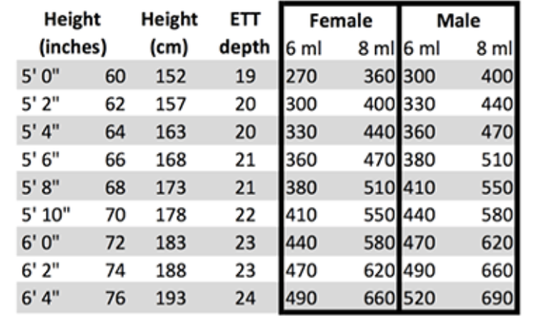
Tube depth

Slide 22
Pharmacology

Slide 23
RSI drugs - Induction
Ketamine - 1-2 mg/kg IVP q5-10 minutes
Etomidate - 0.3 mg/kg IV slow push
Versed - 2.5 mg PRN q2 minutes, caution hypotension

Slide 24
RSI drugs - Ketamine
Dissociative anesthetic/analgesic
IV onset 30 seconds, duration 5-10 minutes
1-2 mg/kg IVP, repeat every 5-10 minutes
Synergy with narcotics, benzos
Ideal for trauma
No real contraindications

Slide 25
RSI drugs - Etomidate
Sedative/hypnotic, mechanism unknown
IV onset 30-60 seconds, duration 10-15 min
0.3 mg/kg IV slow push
Contraindication hypotension

Slide 26
RSI drugs - Versed
Sedative hypnotic, enhances the effects of GABA
IV onset 1-3 minutes, duration 30-60 minutes
2.5 mg PRN q2 minutes
Caution hypotension

Slide 27
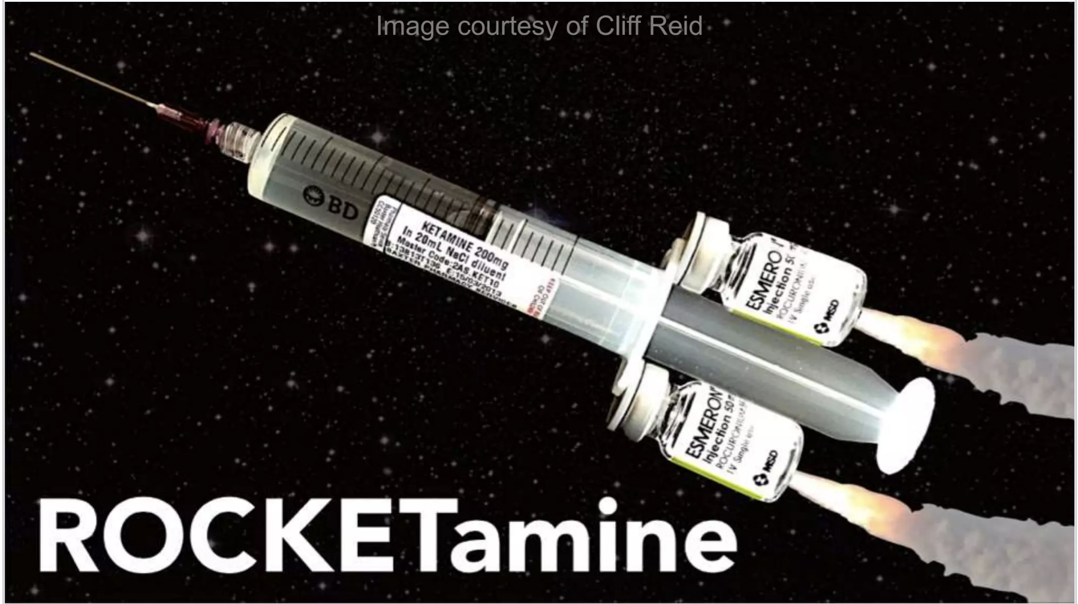

Slide 28
RSI drugs - Paralytic
Rocuronium
Non-depolarizing NM blocker
Onset 1-2 minutes, 30 minute duration of paralysis
1 mg/kg IVP
May not repeat (per protocol)

Slide 29
Surgical airway

Slide 30
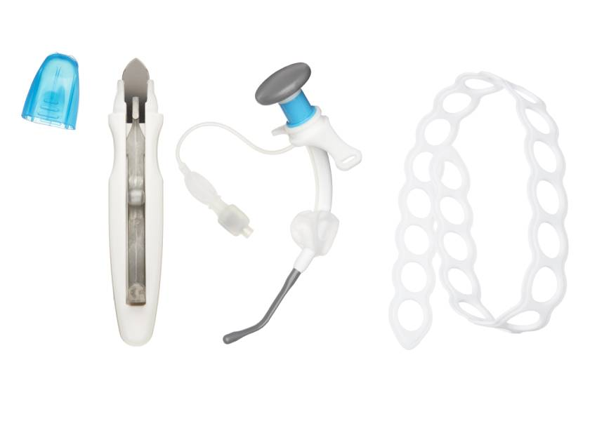
Notes:
Control Cric kit

Slide 31
Video recording

Slide 32
Post-RSI steps
Email me within 24 hours (cc Chief Bowen)
First Due (and video review if available) within 24 hours
Feedback through First Due

