Slide 1
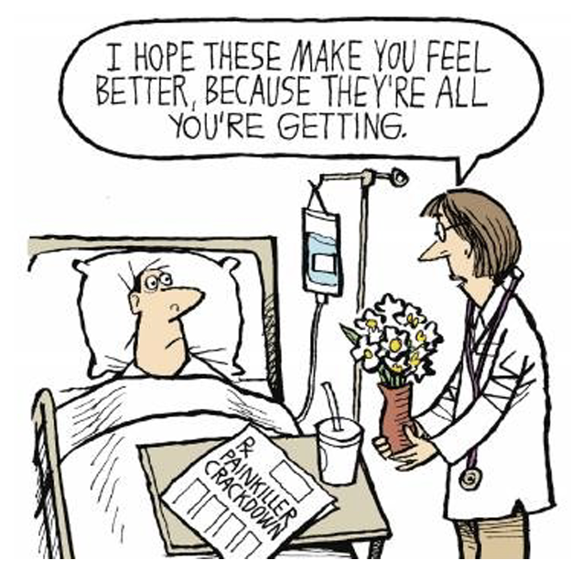
Sedation
Lauren Bailey, November 2025

Slide 2
Terminology
Amnestic - A substance that reduces the ability to recall or remember events
Analgesia - Relief of pain without intentional production of an altered mental state such as sedation
Anxiolysis - A state of decreased apprehension concerning a particular situation in which there is no change in a patient's level of awareness
Hypnotic - Relief of pain without intentional production of an altered mental state such as sedation
Sedative - A substance that induces a calming effect and reduces anxiety

Slide 3
Terminology
Dissociative sedation - A trance-like cataleptic state induced by the dissociative agent ketamine and characterized by profound analgesia and amnesia, with retention of protective airway reflexes, spontaneous respirations, and cardiopulmonary stability
Moderate sedation - A drug-induced depression of consciousness during which patients respond purposefully to verbal commands, either alone or accompanied by light tactile stimulation
Deep sedation - A drug-induced depression of consciousness during which patients cannot be easily aroused but respond purposefully after repeated or painful stimulation

Slide 4
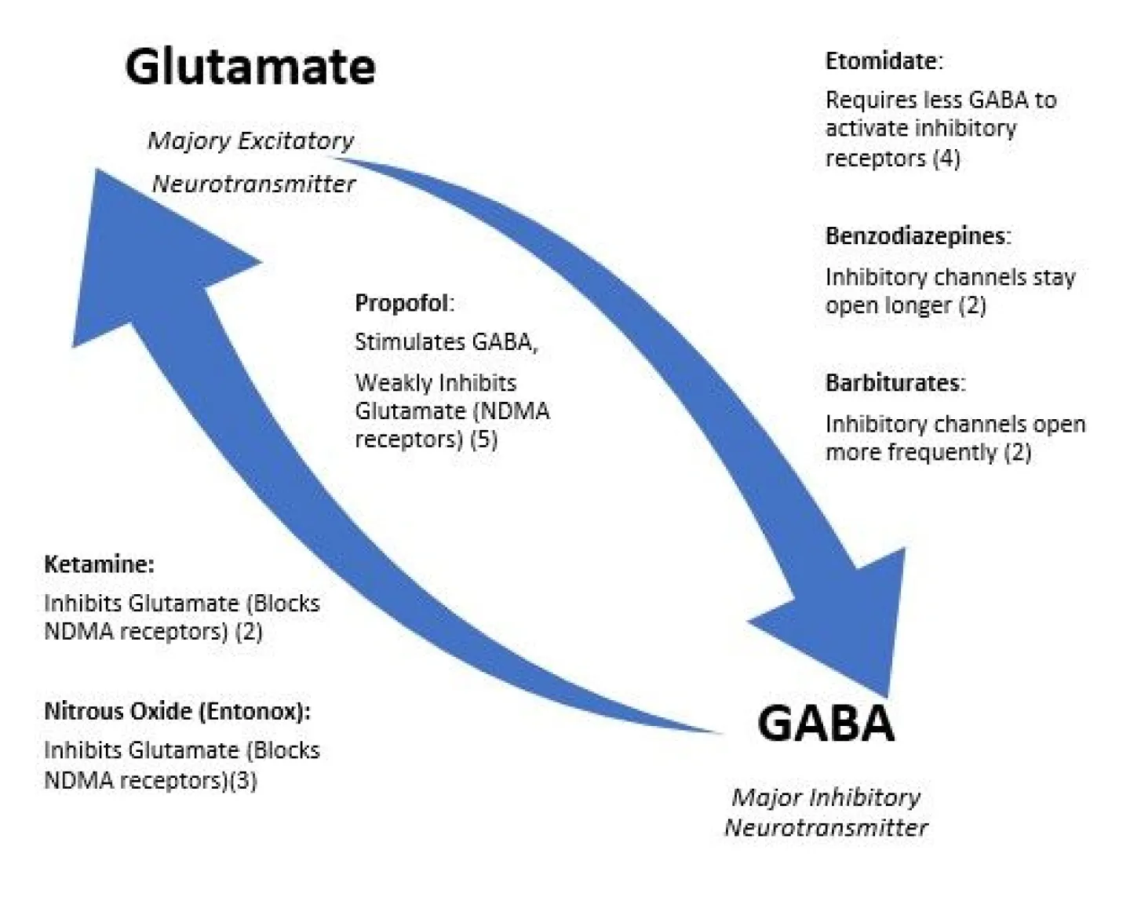
Glutamate and GABA
Glutamate - major CNS excitatory neurotransmitter (GAS!)
GABA - major CNS inhibitory neurotransmitter (BRAKES!)
Most sedatives work by pushing harder on the brakes (stimulating GABA) or taking the foot off the gas pedal (blocking glutamate).

Slide 5
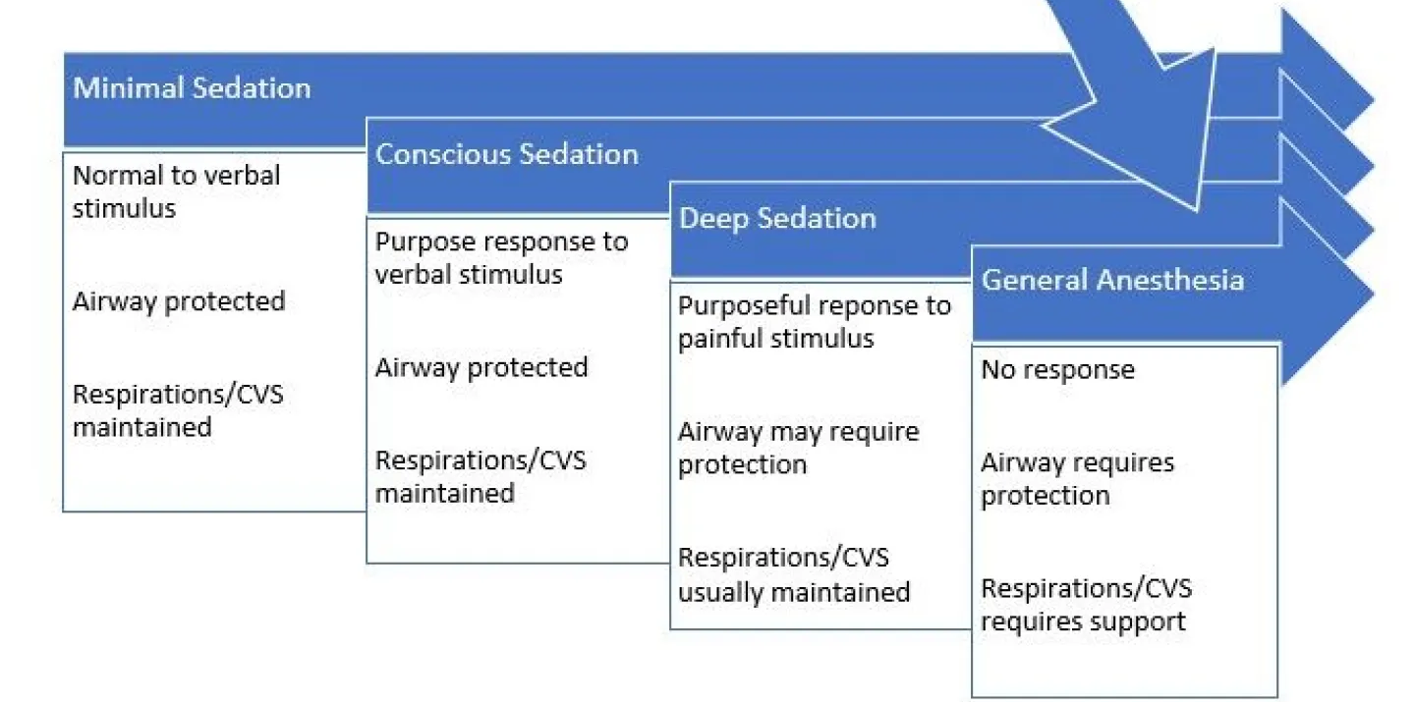
Levels of non-dissociative sedation

Slide 6
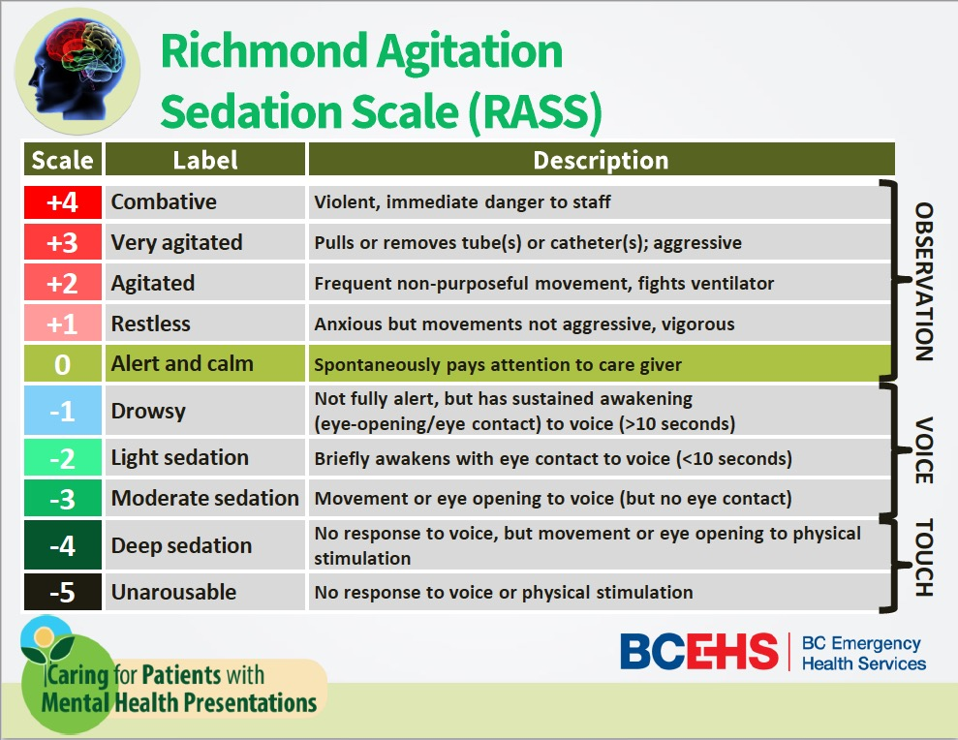
RASS
Notes:
Richmond Agitation Sedation Scale is a 10-point scale used to assess a patient’s level of agitation or sedation, easy to administer, and reliable.

Slide 7
Benzodiazepines (SEDATIVE)
Provide only sedation, no pain relief
Midazolam - IV onset 1-3 min, 2.5-5mg IVP PRN q2min
Lorazepam - IV onset 1-5 min, 1-2mg IVP SLOW, q5-10min

Slide 8
Opioids (ANALGESIA)
Provide only pain relief
Fentanyl - IV immediate onset, 0.5-1mcg/kg, repeat as needed
Old people - reduce dose
Chronic opioid use - consider something else
(Morphine, Dilaudid)

Slide 9

The perfect drug?

Slide 10
Ketamine (ANALGESIA and AMNESIA)
Anesthetic, analgesic, amnestic
IV onset 30 seconds
1-2mg/kg IVP, repeat q5-10 min
Consider 0.1-0.3mg/kg pain dose

Slide 11


FENTANYL

Slide 12
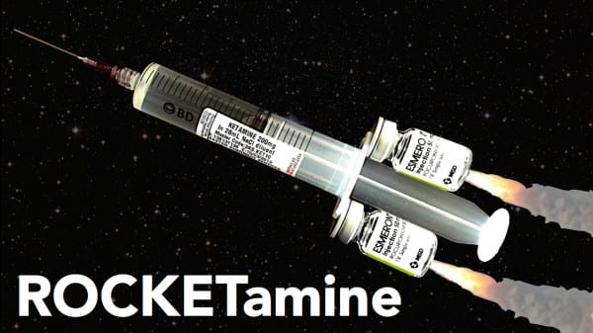
Special Situations
Status epilepticus - etomidate and roc, versed and fentanyl for sedation
Asthma/COPD - ROCKETamine, followed by ketamine and versed/fentanyl for sedation
Trauma - ROCKETamine, followed by ketamine and fentanyl for sedation
Old and altered - etomidate and roc, followed by low dose versed/ketamine/fentanyl for sedation

Slide 13
Questions?

Slide 14

Recognizing Sepsis

Slide 15
Why?
Severe sepsis mortality: 20-40%
Septic shock mortality: 30-54%
Early and rapid treatment is critical - prehospital sepsis alert!
80% of sepsis related deaths could be prevented with timely intervention

Slide 16

Who?
Fever
Recent surgery, infection, hospitalization
Older age, nursing home residents
Immunocompromised
Indwelling catheter/drains

Slide 17
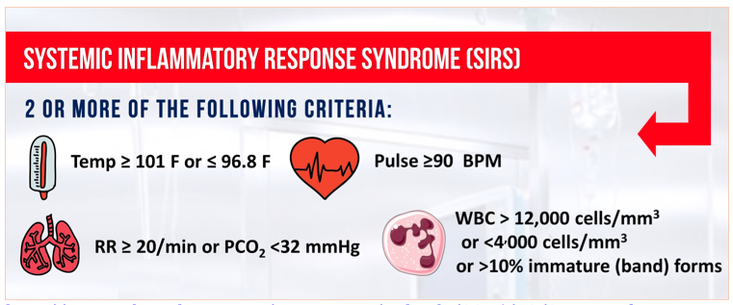
Signs and Symptoms

Slide 18
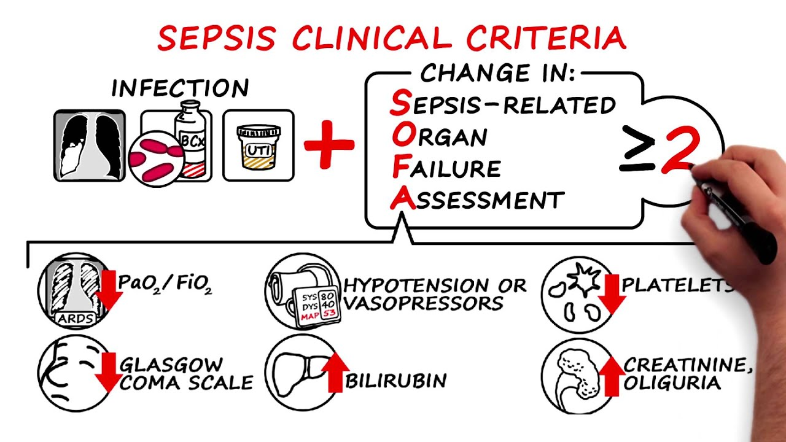
Sepsis

Slide 19
Prehospital screening tools
No gold standard or validated pre-hospital screening tool
qSOFA, Robson screening tool, MSI, PRESS
Use clinical history, exam, and VS to identify suspected sepsis

Slide 20
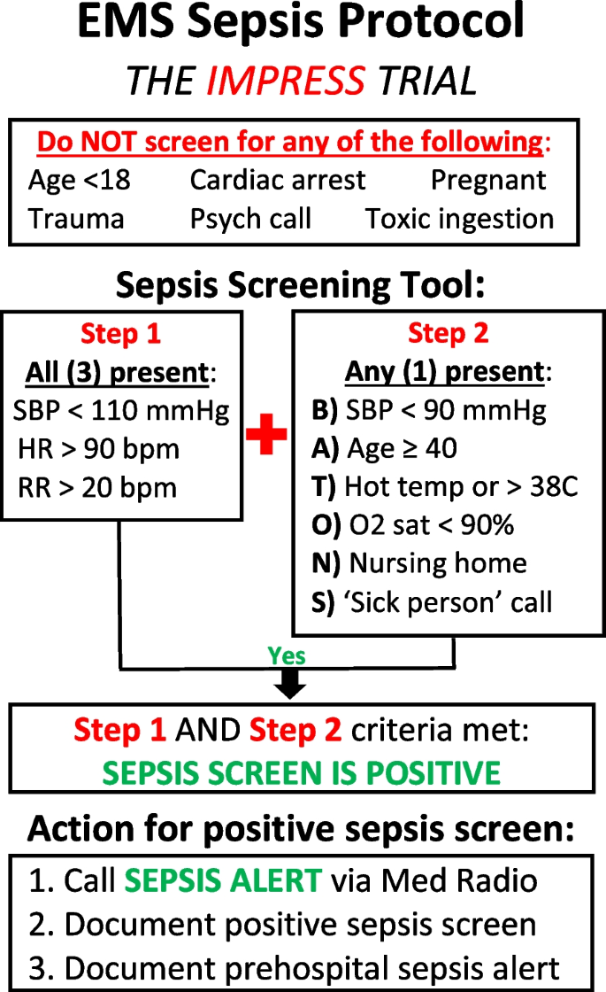

Slide 21
Current NWA protocol
Diagnosed or suspected infection and any two of the following: Altered mental status Heart rate > 90 BPM Respiratory rate > 20 BPM Systolic BP < 90 mmHg Temperature > 101°F (38.3°C) or < 96.8°F (36°C) ETCO₂ < 26 mmHg without hyperventilation present

Slide 22
Universal Patient Care
*Waveform capnography*
PIV access
Administer crystalloid bolus
Confirm and assess lung sounds prior to initiating
Treat hypotension to maintain MAP > 60, do not exceed 30ml/kg IVF
Consider vasopressors early - levophed or epinephrine drips, or just PDP
Notify receiving facility

Slide 23
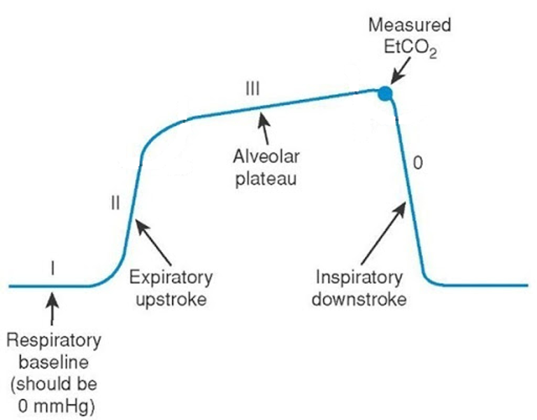
EtCO2 in sepsis
Low prehospital EtCO2 levels predict metabolic acidosis and mortality
In patients with > 2 SIRS criteria, an EtCO2 measurement < 25 strongly correlates with lactate > 4 and increased mortality

Slide 24
How to distinguish between stroke and sepsis?
History
Exam
VS, including EtCO2
Every altered pt should have EtCO2 documented

Slide 25
Questions?

